Slide 1
For first time users to pay dues and create an account click on “JOIN OR RENEW”.

Slide 2
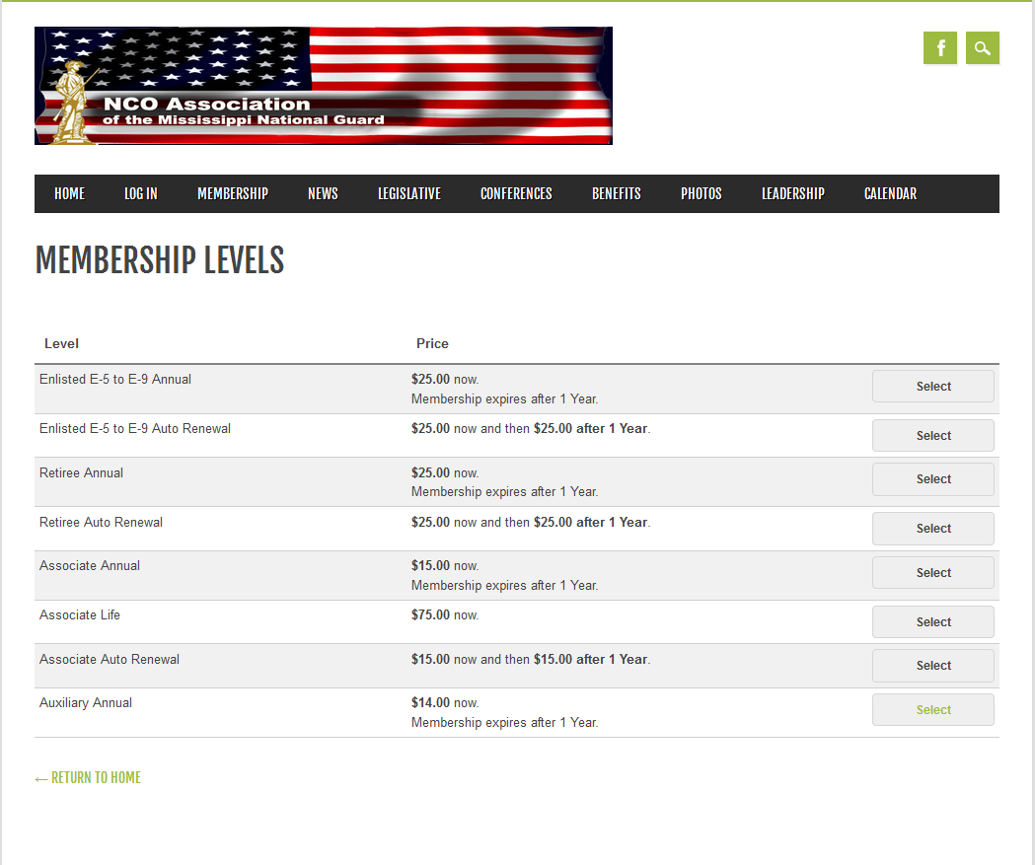
Click on Auxiliary Annual

Slide 3
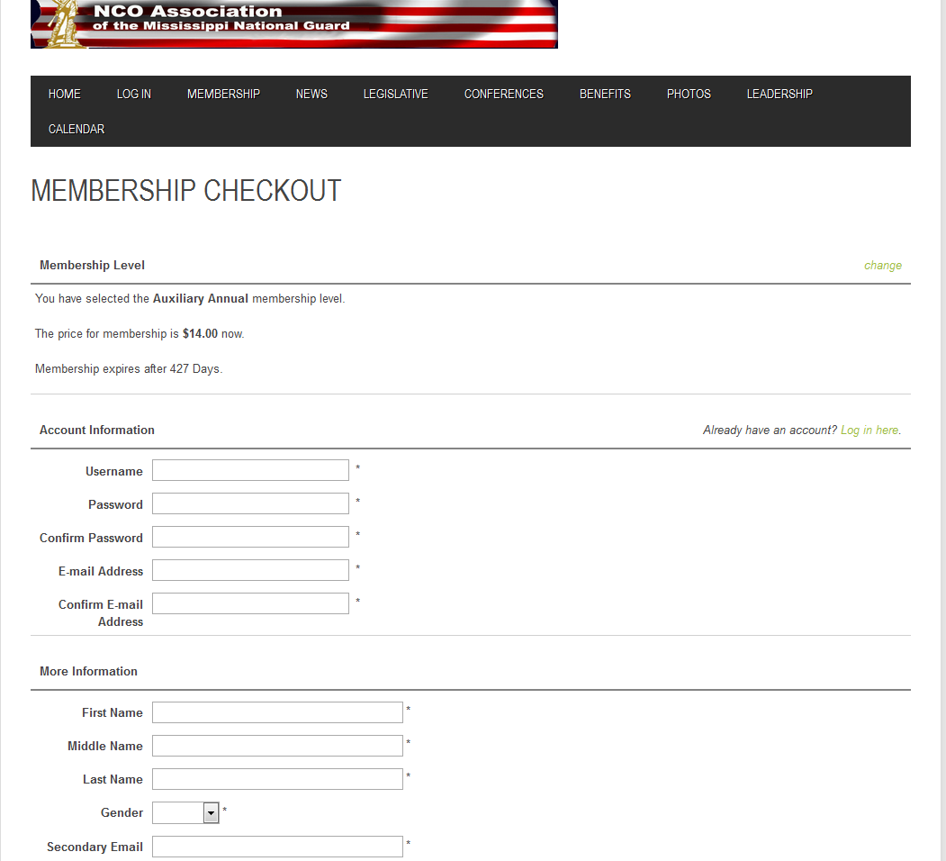
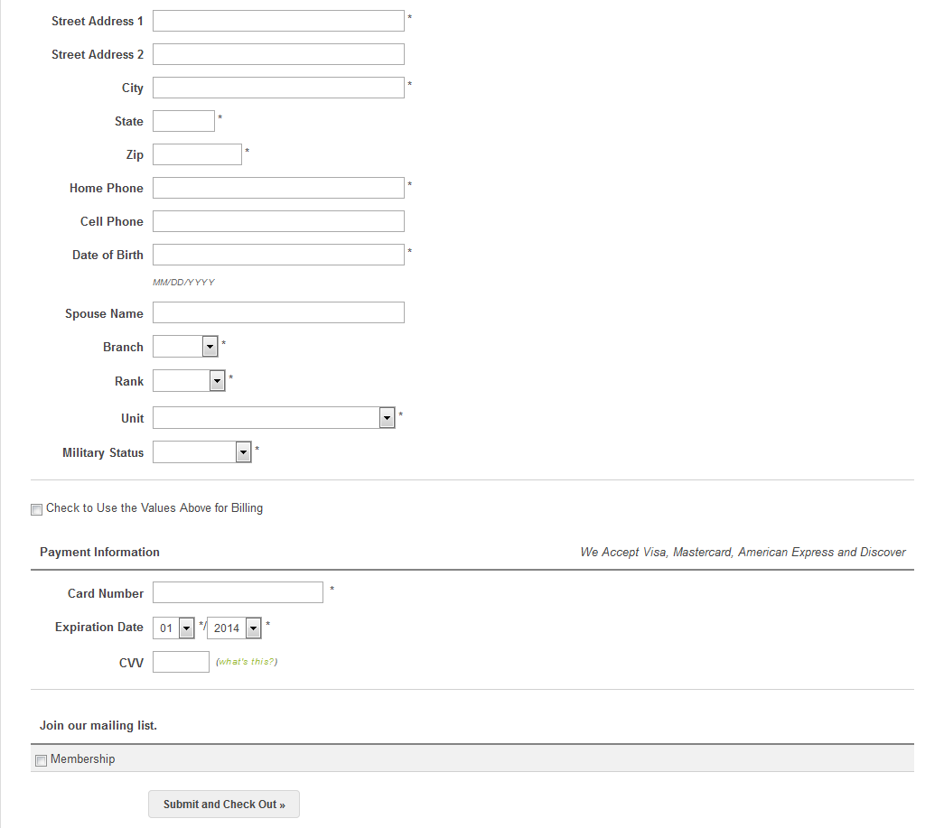
After your account is created you can go to “LOG IN” and start using website.
Fill in all * items and click on “Submit and Check Out”. This will create an account and pay your dues.
Username can be anything you want!
Make sure to provide a valid email!

